Slide 1

Azure Data Factory: Simplifying Cloud Data Integration
A comprehensive guide to Microsoft's cloud-based data integration service that streamlines your ETL/ELT workflows and enables seamless data transformation at scale.

Slide 2
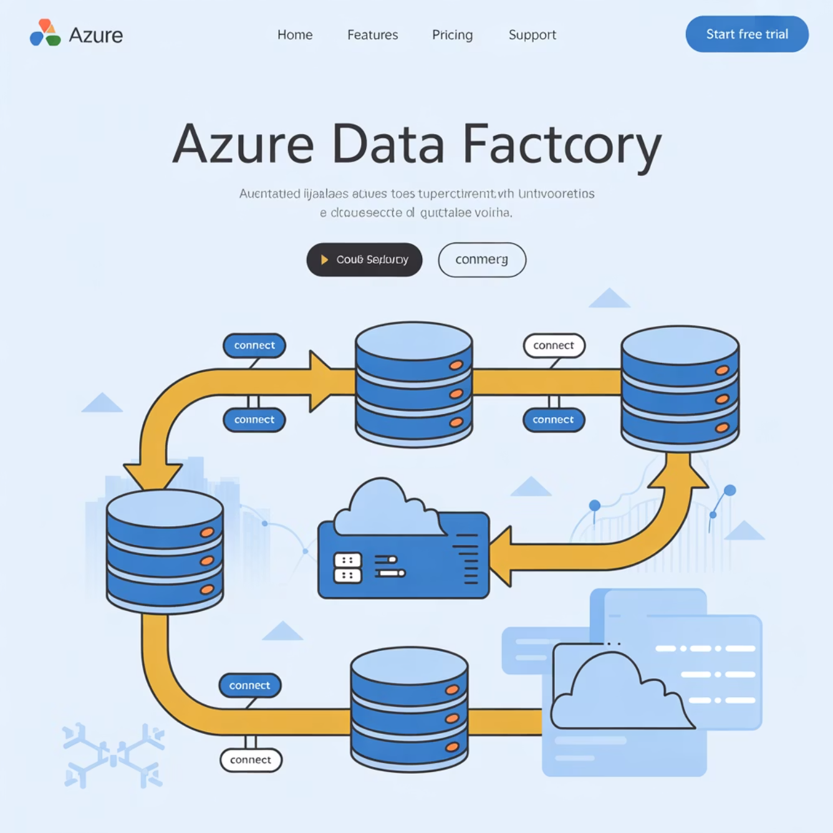
What is Azure Data Factory (ADF)?
Azure Data Factory is Microsoft's cloud-based, serverless data integration service that simplifies how organizations collect, prepare, and transform their data.
As a fully-managed service, ADF eliminates the need to build and maintain complex data integration infrastructure, allowing data engineers and analysts to focus on extracting insights rather than managing systems.
It serves as the central orchestration engine in your modern data platform, connecting disparate data sources and facilitating seamless data movement across your entire data estate.
Build & Schedule Pipelines
Manage Data Flows
Connect Everything
Create ETL and ELT workflows connecting 90+ data sources with intuitive visual tools
Orchestrate data integration processes with flexible scheduling options and monitoring
Bridge on-premises and cloud data sources through secure integration runtimes

Slide 3



Why Use Azure Data Factory?
No-Code/Low-Code Approach
Elastic Scalability
Enterprise-Grade Security
Visual interface allows data engineers of all skill levels to build complex data pipelines without writing extensive code, accelerating development and reducing technical debt.
Dynamically scales to meet your data processing needs, from gigabytes to petabytes, with no infrastructure management required. Pay only for what you use.
Comprehensive security features include data encryption (both at rest and in transit), virtual network integration, and Azure Active Directory authentication.
ADF also provides built-in integration with GitHub and Azure DevOps for version control and CI/CD pipelines, enabling collaborative development and streamlined deployment across environments. This ensures your data integration processes follow modern software development best practices.
With 90+ pre-built connectors, ADF dramatically reduces the time and effort required to integrate diverse data sources, eliminating custom connector development and maintenance costs.

Slide 4
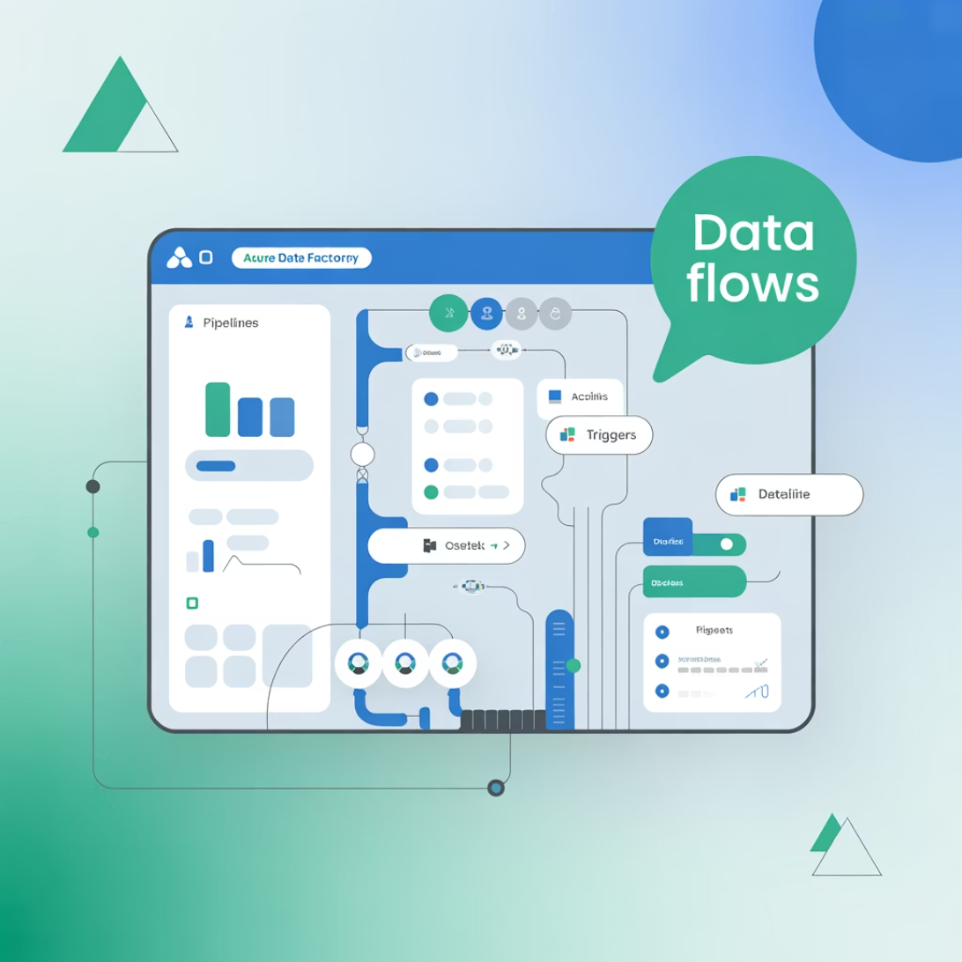
Core Components of ADF
Azure Data Factory is built around five fundamental building blocks that work together to create powerful data integration solutions:
Pipelines
Logical groupings of activities that together perform a specific task. A pipeline might ingest data from a source, transform it, and load it into a destination.
Activities
Individual processing steps within a pipeline that perform specific operations like copying data, transforming data using Spark, or executing stored procedures.
Datasets
Data structures within data stores that simply point to or reference the data you want to use in your activities as inputs or outputs.
Linked Services
Connection strings that define the connection information needed for ADF to connect to external resources like Azure Storage, SQL Database, or Spark clusters.
Triggers
Mechanisms that determine when a pipeline execution should be initiated, including schedule triggers (time-based), tumbling window triggers (periodic), and event-based triggers.
These components provide a flexible framework for creating complex data workflows that can address virtually any data integration scenario, from simple data movement to sophisticated multi-step transformations.

Slide 5
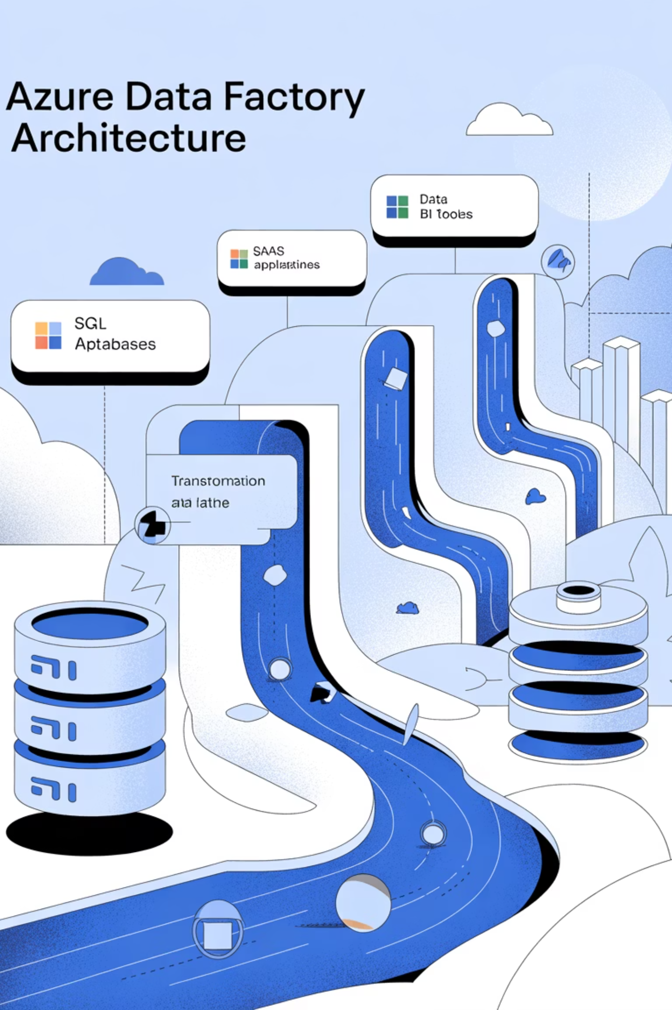
Azure Data Factory Architecture
Azure Data Factory provides a comprehensive architecture for orchestrating data movement between diverse sources and destinations, with powerful transformation capabilities.
This architecture enables organizations to implement both ETL (Extract, Transform, Load) and ELT (Extract, Load, Transform) patterns depending on their specific use cases. The flexible nature of ADF allows it to fit seamlessly into existing data ecosystems while providing a path for modernization.

Slide 6
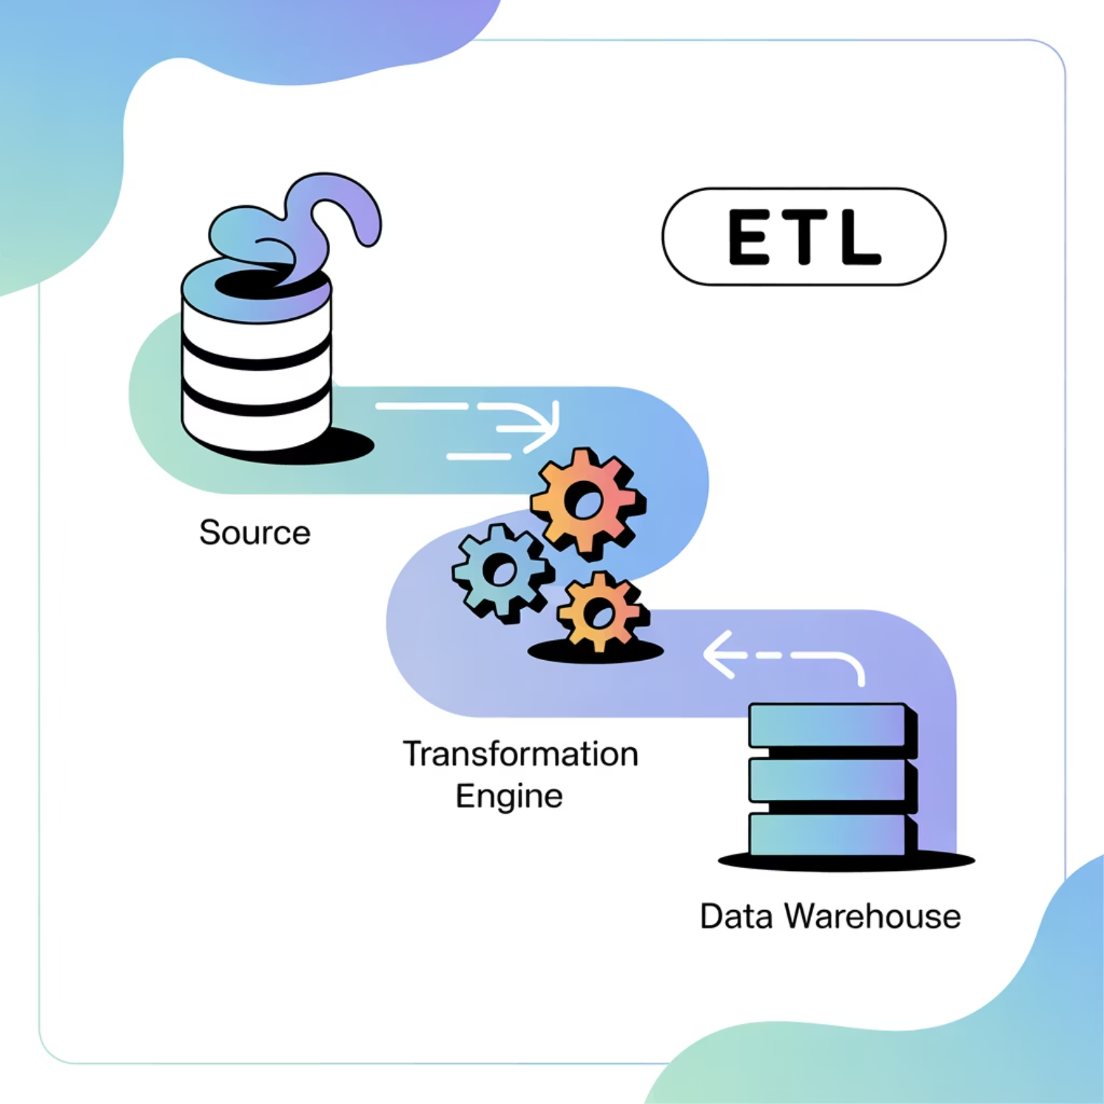
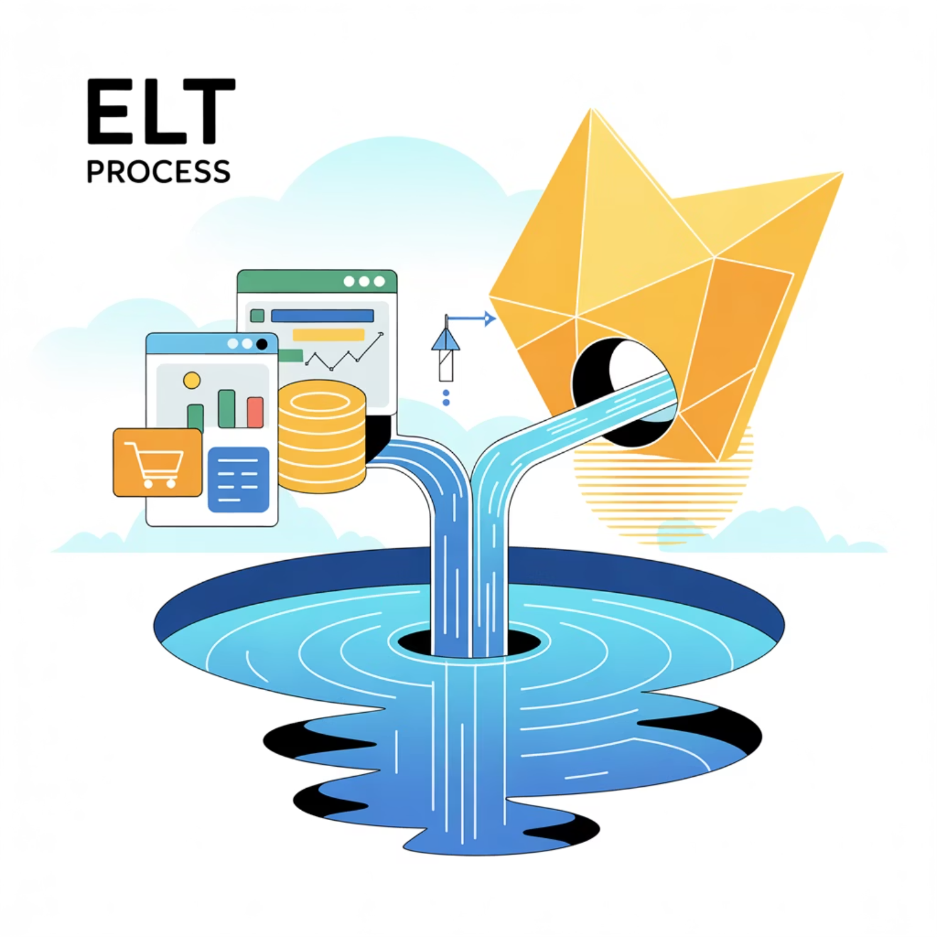
ETL vs ELT in Azure Data Factory
ETL: Extract, Transform, Load
ELT: Extract, Load, Transform
Traditional approach where data is transformed before loading into the destination
Modern cloud approach that loads raw data first, then transforms as needed
Best for:
Best for:
Limited target storage resources
Big data scenarios with massive volumes
Complex transformations needed before storage
Data lakes and modern warehouses
Strict data quality requirements
Exploratory analytics and data science
ADF Implementation: Use Data Flows or external compute like Azure Databricks
ADF Implementation: Use Copy Activity for loading, then transform with Azure Synapse Analytics or Databricks
Azure Data Factory excels at supporting both patterns flexibly, allowing organizations to choose the most appropriate approach for each specific data pipeline based on their technical requirements, existing skillsets, and business needs.

Slide 7
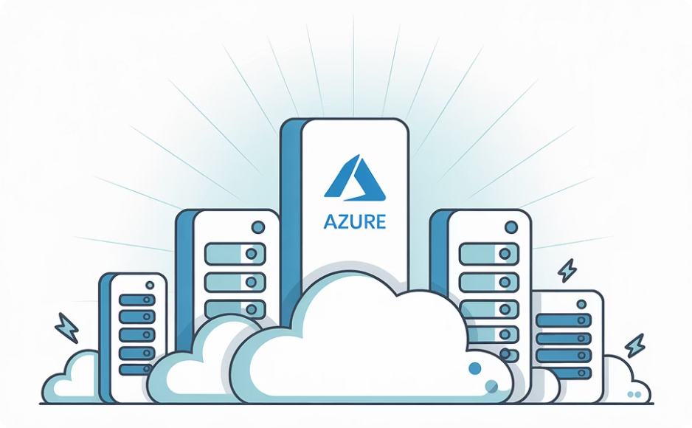


Integration Runtime: The Compute Backbone
The Integration Runtime (IR) is the critical compute infrastructure that powers Azure Data Factory's data movement and transformation capabilities. It serves as the bridge between your data sources and destinations.
Azure Integration Runtime
Self-hosted Integration Runtime
Azure-SSIS Integration Runtime
The default, fully managed cloud IR that handles data movement between cloud data stores and dispatches external activities to compute services like Azure Databricks.
Installed in your on-premises environment or virtual network, enabling secure data movement between on-premises data stores and the cloud.
Specialized runtime that provides a lift-and-shift environment for executing existing SQL Server Integration Services (SSIS) packages directly in Azure.
Best for: Hybrid scenarios requiring access to private networks and data sources behind firewalls
Best for: Cloud-to-cloud integration scenarios with no private network requirements
Best for: Organizations with significant investment in SSIS packages wanting to modernize
The right Integration Runtime choice is critical for optimizing performance, ensuring security compliance, and enabling access to your specific data sources. Multiple IR types can be used in the same ADF instance to address different scenarios.

Slide 8
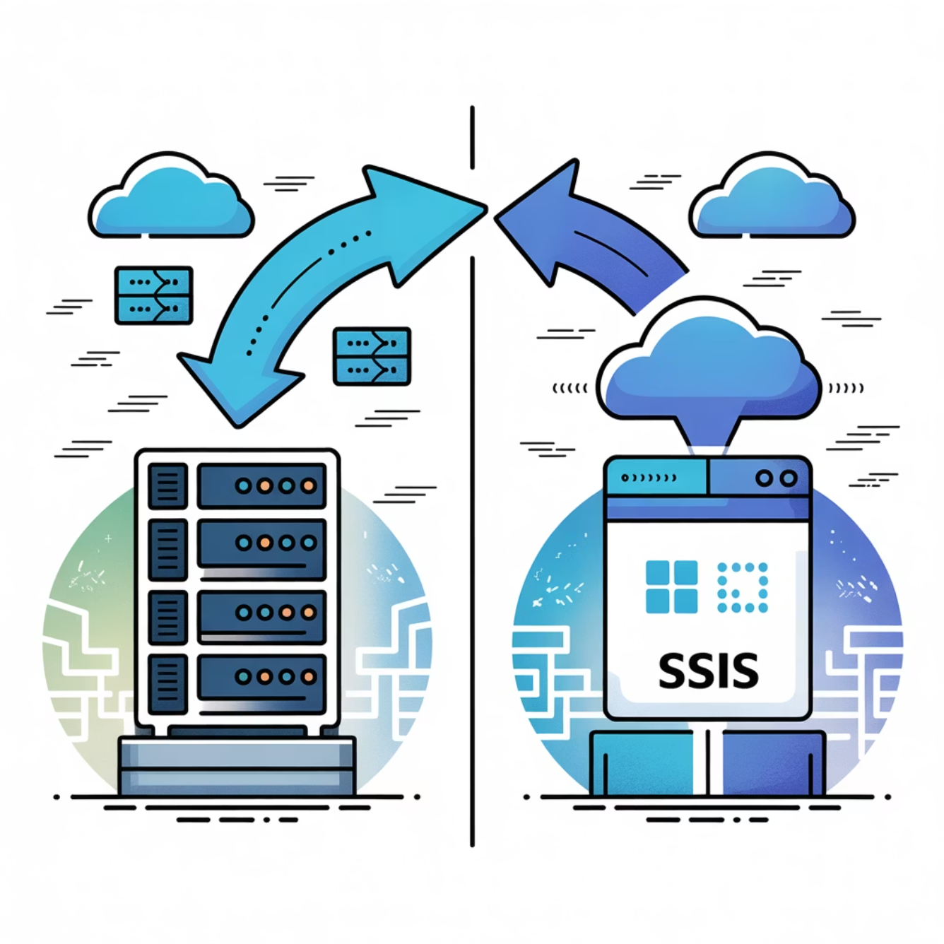
Lift and Shift SSIS Packages
For organizations with substantial investments in SQL Server Integration Services (SSIS) packages, Azure Data Factory offers a seamless migration path without requiring a complete rewrite of existing ETL logic.
Key Benefits of SSIS in ADF:
Preserve existing investments in SSIS packages and skills
Modernize infrastructure without changing business logic
Scale elastically with cloud-based compute resources
Integrate with modern data services in Azure ecosystem
Centralize management of all data integration workloads
The Azure-SSIS Integration Runtime provides a familiar execution environment that is fully compatible with the on-premises SSIS runtime, ensuring that existing packages run as expected while gaining cloud benefits.
"We migrated over 200 SSIS packages to Azure Data Factory without modifying a single package, reducing our infrastructure costs by 40% while improving reliability."
— Data Engineering Manager at a Fortune 500 Company

Slide 9
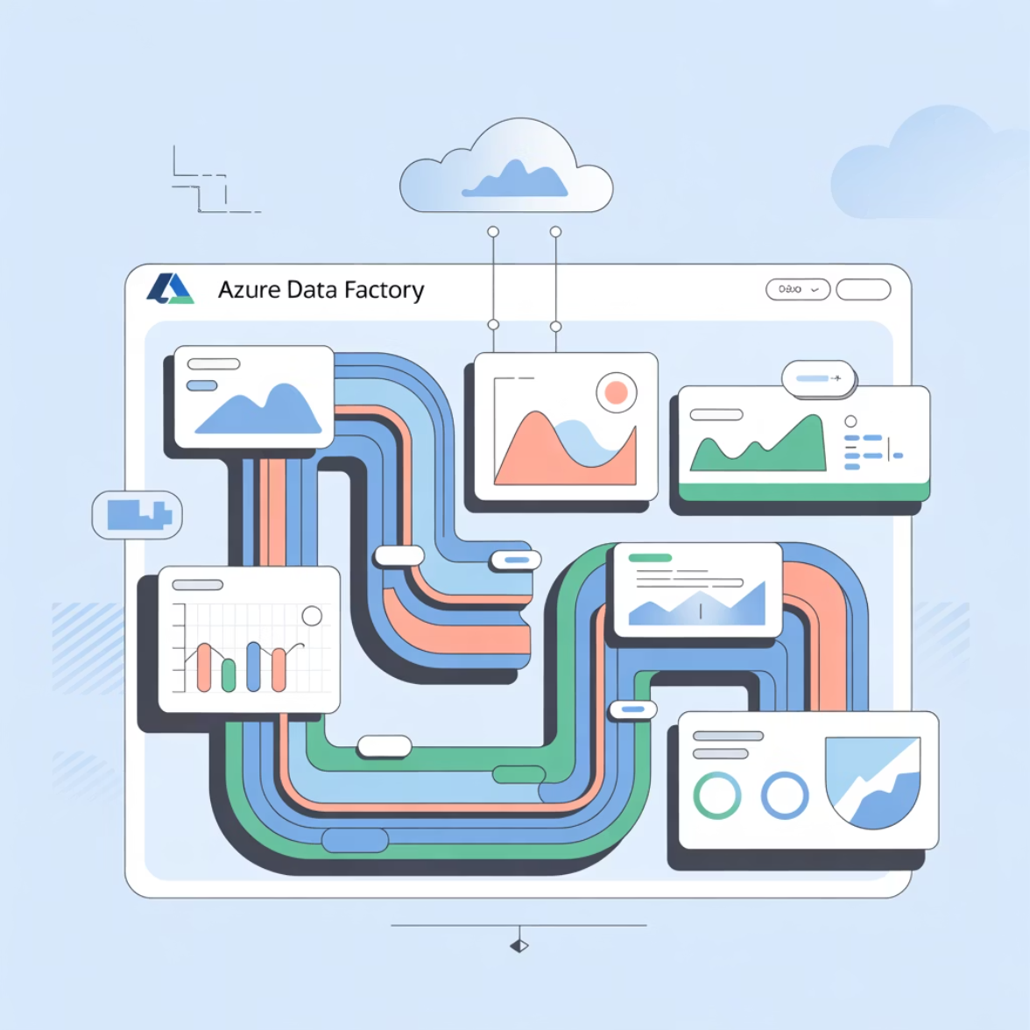
Mapping Data Flows: Code-Free Data Transformation
Mapping Data Flows represent Azure Data Factory's answer to complex data transformation needs without requiring code or a deep understanding of distributed computing frameworks.
How Mapping Data Flows Work:
Behind the scenes, Mapping Data Flows utilize Apache Spark clusters provisioned and managed automatically by Azure, handling all the complexity of distributed data processing while you focus on data logic.
Key Capabilities:
Visual transformation builder with no-code experience
Data preview at each transformation step
Schema drift handling for resilient pipelines
Complex transformations including joins, aggregates, pivots
Derived column expressions for data manipulation
Conditional splits and merges for complex flows
Auto-scaling Spark clusters for performance
Mapping Data Flows democratize data transformation by making complex big data processing accessible to data analysts and engineers without Spark expertise, dramatically accelerating time to insight.

Slide 10
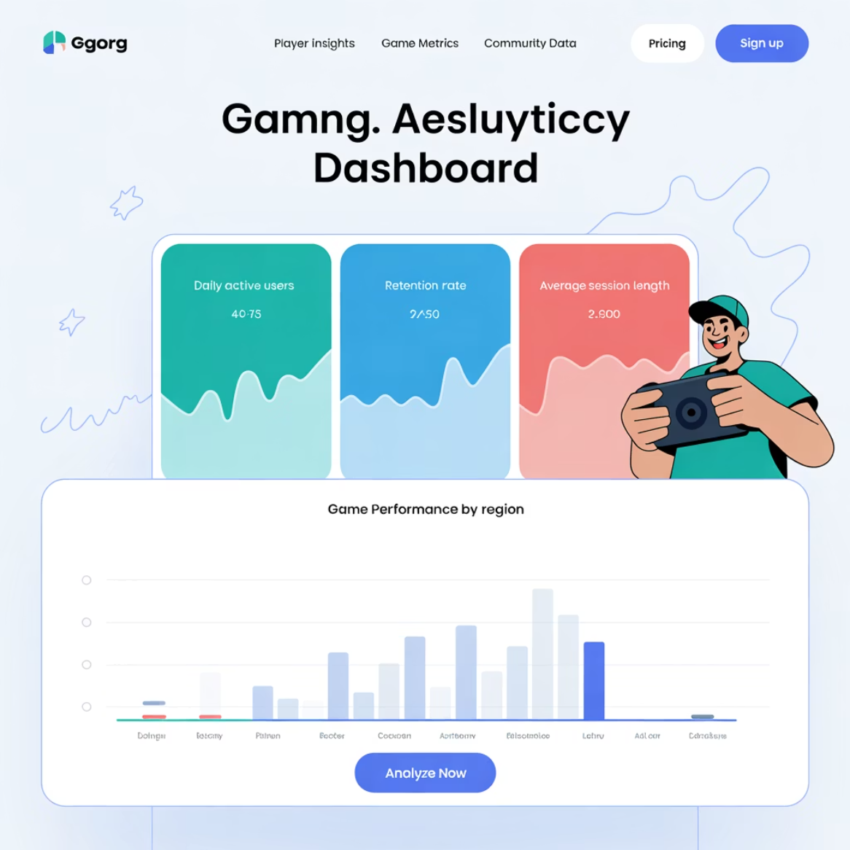
Real-World Use Case: Gaming Company Analytics
A leading online gaming company leveraged Azure Data Factory to transform their analytics capabilities and gain deeper insights into player behavior across their portfolio of games.
Data Collection Challenge
ADF Solution
Petabytes of game logs generated daily across multiple platforms (mobile, console, PC) stored in diverse systems including on-premises SQL Server, Cosmos DB, and blob storage.
Created automated pipelines to ingest, join, and transform data from all sources. Used self-hosted IR for on-premises data and mapping data flows for complex transformations.
Analytics Platform
Automation
Refined data published to Azure Synapse Analytics, enabling real-time dashboards for game performance, player retention, and monetization metrics.
Event-based triggers launch pipelines when new game data arrives. Scheduled triggers refresh aggregated reports at specific intervals. Error handling automatically retries failed operations.
Business Outcomes:
Reduced data processing time from 24+ hours to under 2 hours
30% increase in player retention through more targeted engagement campaigns based on behavior insights
Eliminated 6 different ETL tools by consolidating on ADF
Data engineering team focused on insights instead of infrastructure

Slide 11
Security & Governance in ADF
Azure Data Factory is designed with enterprise-grade security and compliance controls to protect sensitive data throughout the entire integration process.
Data Protection
Access Control
Compliance & Governance
Encryption of data in transit using TLS 1.2 or higher
Fine-grained role-based access control (RBAC) via Azure Active Directory (Entra ID)
Integration with Azure Policy for enforcing organizational standards
Encryption at rest with Microsoft-managed keys or customer-managed keys
Support for resource tags to track ownership, environment, and cost allocation
Customizable roles for separation of duties between administrators, developers, and operators
Secure access to data stores with credentials stored in Azure Key Vault
Microsoft Defender for Cloud integration for threat protection and security recommendations
Managed identities for secure, password-free authentication to resources
Private endpoints for secure connectivity within virtual networks
Compliance with major regulatory standards including GDPR, HIPAA, ISO 27001, SOC, and more
Detailed activity logs of user actions for auditing purposes
These comprehensive security features ensure that organizations can implement robust data integration solutions while maintaining strict compliance with internal policies and external regulations.

Slide 12
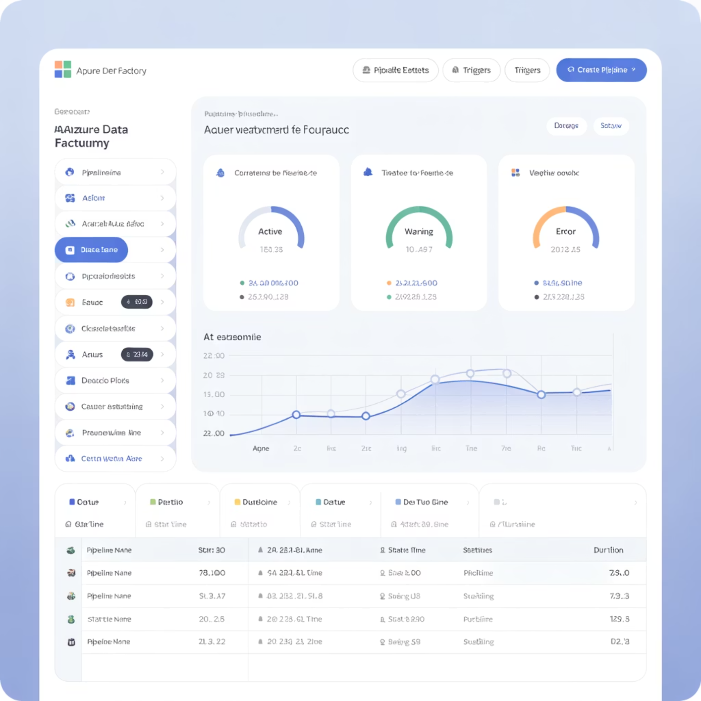
Monitoring & Management
Azure Data Factory provides robust tools for monitoring and managing your data integration workflows:
Built-in Monitoring Dashboard
Visual pipeline run history with detailed execution status
Activity-level metrics and logs for granular troubleshooting
Performance statistics and resource utilization metrics
Filter and search capabilities for complex deployments
Alerts and Notifications
Configurable alerts for pipeline failures or performance issues
Integration with Azure Monitor action groups for email, SMS, or webhook notifications
Custom alert thresholds based on metrics or activity logs
Advanced Monitoring Integration
Azure Monitor: Centralized monitoring across all Azure resources
Log Analytics: Advanced query and analysis of ADF execution logs
Application Insights: Performance monitoring and diagnostics
Power BI: Custom dashboards for executive reporting and historical trends
These comprehensive monitoring capabilities enable operations teams to proactively identify and resolve issues before they impact business processes, ensuring reliable data delivery for critical business applications.

Slide 13
Getting Started: Creating Your First Pipeline
Building your first Azure Data Factory pipeline is straightforward with Microsoft's intuitive tools and extensive documentation.
Define Connections
Set Up Your Environment
Create Linked Services to establish connections to your source and destination data stores. Azure Data Factory supports 90+ connectors including SQL databases, blob storage, APIs, and SaaS applications.
Choose either the Azure Portal for a completely browser-based experience or Visual Studio Code with Azure Extensions for a more developer-friendly environment.
Define Datasets that represent the structure of your source and destination data, specifying file formats, paths, and relevant properties.
Create a new Data Factory instance in your Azure subscription, selecting the appropriate region and configuration options.
Test and Deploy
Build Your Pipeline
Use the Debug feature to test your pipeline with sample data, validating that it works as expected.
Design a pipeline using the visual interface, adding activities such as Copy Data for simple data movement or Mapping Data Flow for complex transformations.
Review execution details and performance metrics, making any necessary adjustments.
Configure each activity with the appropriate source and sink datasets, and set up any required transformations or mappings.
Publish your validated pipeline to make it available for production use, and optionally set up triggers for automatic execution.

Slide 14
Summary: Why Azure Data Factory?
Azure Data Factory stands as a cornerstone of modern data integration in the cloud, offering unparalleled capabilities for organizations looking to unify their data assets and derive meaningful insights.
Key Advantages:
Simplified Hybrid Integration
Modern Data Engineering
Seamlessly connect and move data between on-premises systems and cloud resources through secure and reliable pipelines, breaking down data silos without complex networking or infrastructure.
Support for both code-free visual interfaces and code-based approaches accommodates diverse team skills and complex requirements, enabling both citizen integrators and professional engineers.
Unlimited Scalability
Azure Ecosystem Integration
Dynamically scale to handle data volumes from gigabytes to petabytes without infrastructure management, eliminating capacity planning headaches and infrastructure bottlenecks.
Seamless connections to Azure Synapse Analytics, Azure Databricks, Azure Machine Learning, and the broader Microsoft ecosystem create a comprehensive platform for advanced analytics and AI.
By providing a unified, scalable, and secure platform for data integration, Azure Data Factory enables organizations to focus on deriving value from data rather than managing complex integration infrastructure.

Slide 15
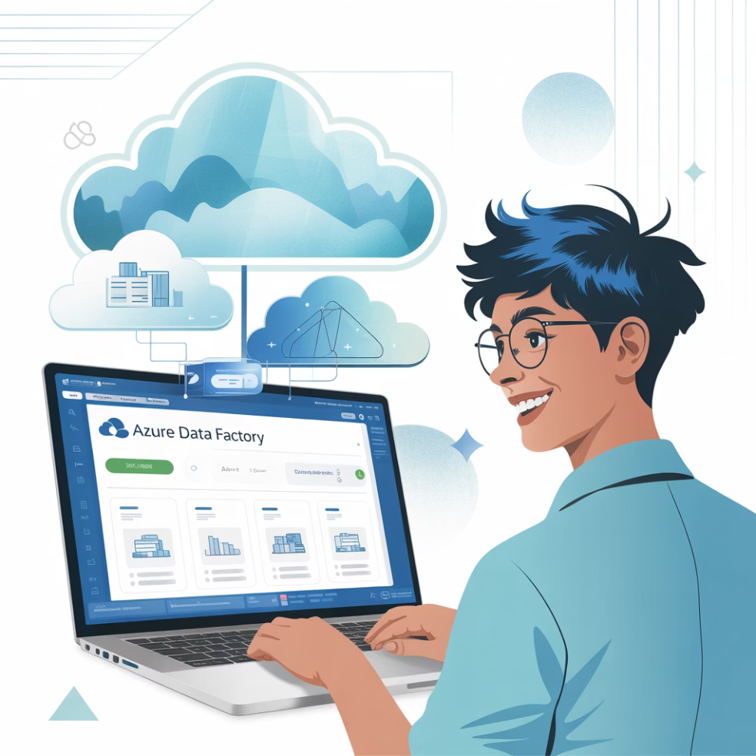
Ready to Transform Your Data Workflows?
Take the Next Steps with Azure Data Factory:
Explore the Service
Visit the Azure Data Factory website for comprehensive documentation, tutorials, and demos showing the platform in action.
Start a Free Trial
Sign up for an Azure free account that includes Azure Data Factory with $200 in credits to experiment with real pipelines using your own data.
Learn Best Practices
Explore Microsoft Learn modules and hands-on labs specifically designed for Azure Data Factory to master this powerful service.
"Azure Data Factory has revolutionized how we approach data integration, reducing development time by 65% while improving reliability across our entire data estate."
Join the Community
Connect with other ADF users through the Microsoft Tech Community and GitHub repositories to share knowledge and solutions.
Start building scalable, secure, and automated data pipelines in minutes!

